Slide 1

筆堆歐姆蛋系列 OMELETT
前菜系列 STARTERS
健康沙拉系列 SALAD
義大利麵系列 PASTA
主廚好推薦 SPECIAL MEAL
燉飯系列 RISOTTO
帕尼尼系列 PANINI
筆堆美式創意料理餐廳

Slide 2


筆堆歐姆蛋系列
OMELET
Veggie Omelet
Bacon & mushroom
Denver Omelet
Spinach & Smoked Salmon

Slide 3
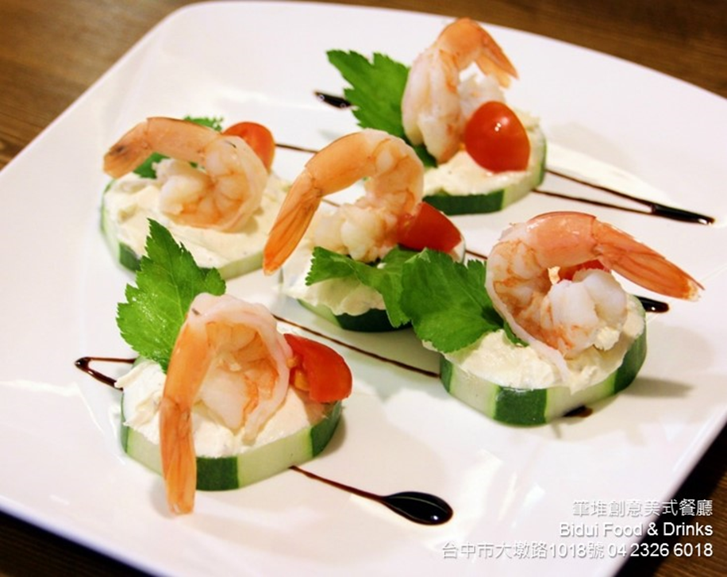
前菜系列
STARTERS
Fries w / Garlic Ailoli Sauce
Calamari
Pulled Pork Cheese Fries
Pulled Pork Nachos
Smoked Salmon Carpacio
Bidui’s Chicken Wings
Buidi’s Combo

Slide 4
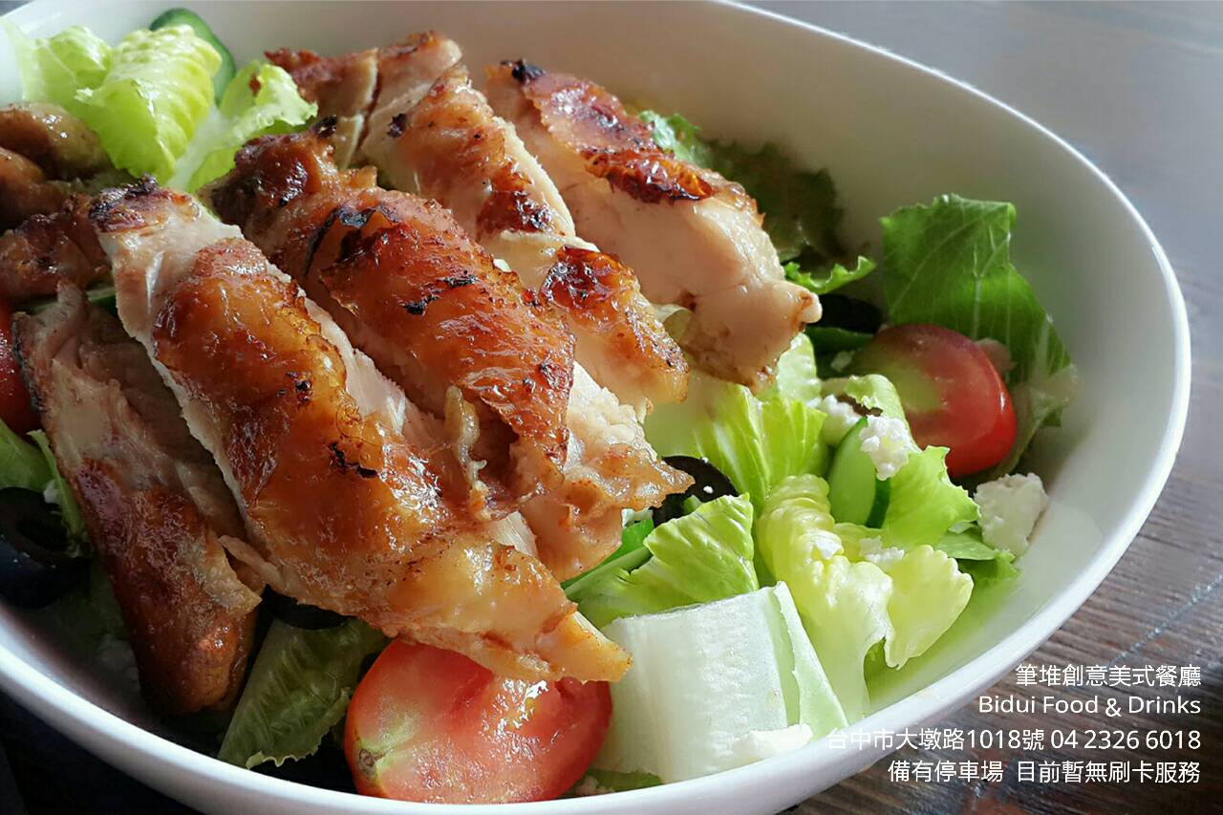
健康沙拉系列
SALAD
Bidui’s Salad
Greek Salad with Lemon Vinaigrette
Ceasar Salad
Two choices of meat
A. Chicken breast
B. Salmon Steak

Slide 5
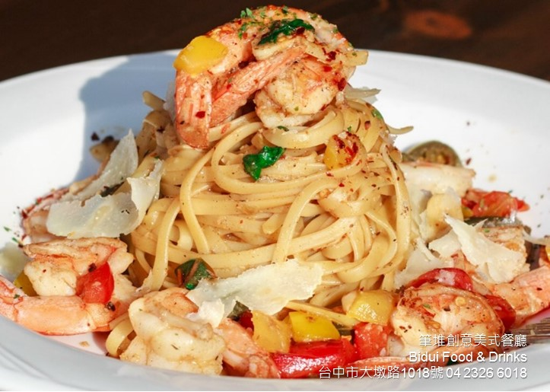
義大利麵系列
PASTA
Tomato & Basil Spaghetti
Clam un White Wine
Chicken Pesto Cream
Carbonara
Shrimp Scampi
Porcini Mushroom and Truffle
Seafood Arabiata
Bacon & Mussel Cream
Beef Bourguignon

Slide 6
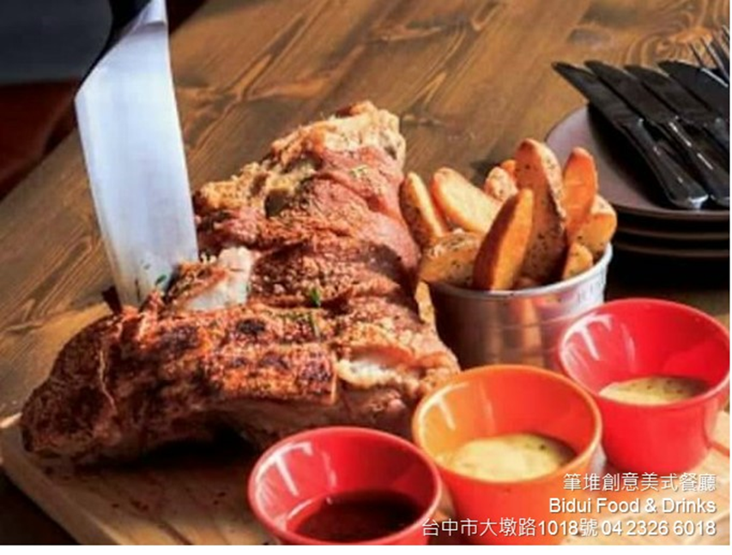
主廚推薦
SPECIAL MEAL
Norwegian Salmon Lemon & Garlic Cream Sauce
Bidui BBQ Ribs
(24 oz + -)
Crispy Pata
(64 oz + -)

Slide 7
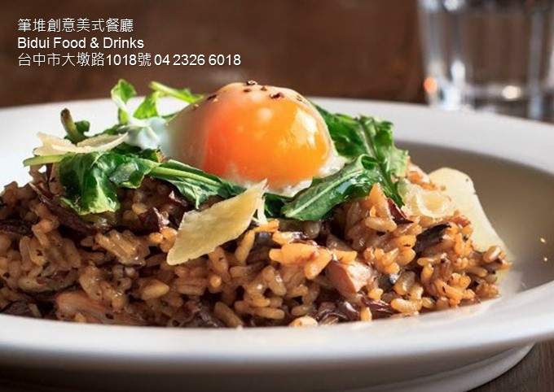
燉飯系列
RISOTTO
Porcini Mushroom Truffle Risotto
Seafood Tomato Risotto
Squid Risotto Negra
Seafood Pesto Cream Risotto

Slide 8
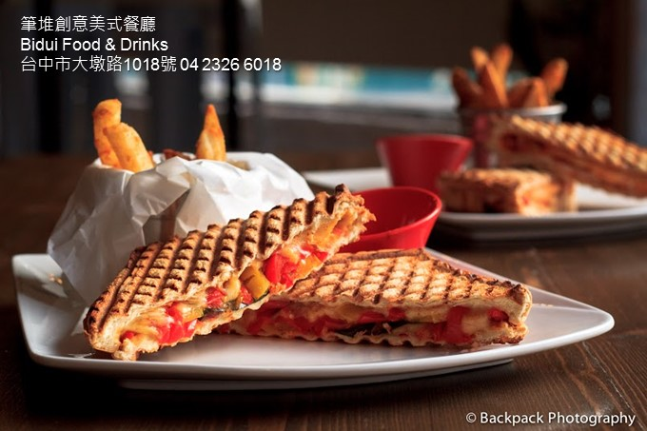
帕尼尼系列
PANINI
Ham & Cheese Melt
BBQ Pulled pork
Nacho Cuban
Mushroom overload
Chicken saltimbocca
Meat Lover
Roast beef onion
Grilled Salmon Steak Cream Cheese

